Slide 1
10 Body Language Mistakes During Presentations

Slide 2
Non-verbal communication can impact your presentation at large. Several studies have shown that body language contributes both in a positive and negative way to a presenter’s influence. Body language is extremely important as you walk into a room to deliver a presentation. Your behaviour helps the audience to figure out your personality and message much before you begin the presentation.

Slide 3
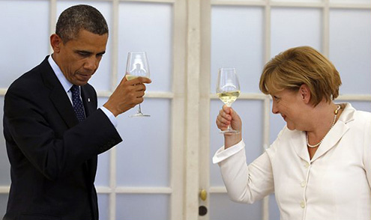
1. Avoiding eye contact Let’s start from the eyes. Avoiding eye contact often implies deceit towards the audience. Always try to maintain an eye contact with the audience while making any point even if it is for a short duration. But don’t break the contact too rapidly. Remember: Eye contact can help you persuade the audience better on any particular matter since it signifies the confidence of the presence.

Slide 4
2. Rolling of the eyes. Don’t even think of trying it since rolling the eyes sends an attitude of disrespect towards the audience. Rolling of the eyes tells your audience that you are lying to them. Remember: Try making a firm eye contact to convey your preparedness towards the presentation. A little smile can be a great add-on.

Slide 5
Interesting, right?
This is just a sneak preview of the full presentation. We hope you like it! To see the rest of it, just click here to view it in full on PowerShow.com. Then, if you’d like, you can also log in to PowerShow.com to download the entire presentation for free.

